Slide 1
Quick-Sort
7 4 9 6 2 → 2 4 6 7 9
4 2 → 2 4
7 9 → 7 9
2 → 2
9 → 9

Slide 2
We will look at this later …
Algorithm | Time | Notes
selection-sort | O(n²) | in-place slow (good for small inputs)
insertion-sort | O(n²) | in-place slow (good for small inputs)
quick-sort | O(n log n) expected | in-place, randomized fastest (good for large inputs)
heap-sort | O(n log n) | in-place fast (good for large inputs)
merge-sort | O(n log n) | sequential data access fast (good for huge inputs)

Slide 3
Quick-Sort
Quick-sort is a randomized sorting algorithm based on the divide-and-conquer paradigm:
Divide: pick a random element x (called pivot) and partition S into
L elements less than x
E elements equal x
G elements greater than x
Recur: sort L and G
Conquer: join L, E and G
x
x
L
G
E
x

Slide 4
Execution Example
Pivot selection
7 2 9 4 3 8 6 1 → 1 2 3 4 6 7 8 9
7 2 9 4 → 2 4 7 9
3 8 6 1 → 1 3 8 6
2 → 2
9 4 → 4 9
3 → 3
8 → 8
9 → 9
4 → 4

Slide 5
Execution Example (cont.)
Partition, recursive call, pivot selection
7 2 9 4 3 8 6 1 → 1 2 3 4 6 7 8 9
2 4 3 1 → 2 4 7 9
3 8 6 1 → 1 3 8 6
2 → 2
9 4 → 4 9
3 → 3
8 → 8
9 → 9
4 → 4

Slide 6
Execution Example (cont.)
Partition, recursive call, base case
7 2 9 4 3 8 6 1 → → 1 2 3 4 6 7 8 9
2 4 3 1 →→ 2 4 7
3 8 6 1 → 1 3 8 6
1 → 1
9 4 → 4 9
3 → 3
8 → 8
9 → 9
4 → 4

Slide 7
Execution Example (cont.)
Recursive call, …, base case, join
7 2 9 4 3 8 6 1 → 1 2 3 4 6 7 8 9
2 4 3 1 → 1 2 3 4
3 8 6 1 → 1 3 8 6
1 → 1
4 3 → 3 4
3 → 3
8 → 8
9 → 9
4 → 4

Slide 8
Execution Example (cont.)
Recursive call, pivot selection
7 2 9 4 3 8 6 1 → 1 2 3 4 6 7 8 9
2 4 3 1 → 1 2 3 4
7 9 8 1 → 1 3 8 6
1 → 1
4 3 → 3 4
8 → 8
9 → 9
9 → 9
4 → 4

Slide 9
Execution Example (cont.)
Partition, …, recursive call, base case
7 2 9 4 3 8 6 1 → 1 2 3 4 6 7 8 9
2 4 3 1 → 1 2 3 4
7 9 8 1 → 1 3 8 6
1 → 1
4 3 → 3 4
7 → 7
9 → 9
4 → 4

Slide 10
Execution Example (cont.)
Join, join
7 2 9 4 3 8 6 1 → 1 2 3 4 6 7 8 9
2 4 3 1 → 1 2 3 4
7 9 8 → 17 8 9
1 → 1
4 3 → 3 4
8 → 8
9 → 9
7 → 7
9 → 9
4 → 4

Slide 11
Quick-Sort Tree
An execution of quick-sort is depicted by a binary tree
Each node represents a recursive call of quick-sort and stores
Unsorted sequence before the execution and its pivot
Sorted sequence at the end of the execution
The root is the initial call
The leaves are calls on subsequences of size 0 or 1
L=2,4 E=6, G=7,9
7 4 9 6 2 → 2 4 6 7 9
L=2 E=4, G=none
4 2 → 2 4
7 9 → 7 9
2 → 2
9 → 9

Slide 12
Partition
We partition an input sequence as follows:
We remove, in turn, each element y from S and
We insert y into L, E or G, depending on the result of the comparison with the pivot x
Each insertion and removal is at the beginning or at the end of a sequence, and hence takes O(1) time
Thus, the partition step of quick-sort takes O(n) time
Algorithm partition(S, p)
Input sequence S, position p of pivot
Output subsequences L, E, G of the elements of S less than, equal to, or greater than the pivot, resp.
L, E, G ← empty sequences
x ← S.erase(p)
while ¬S.empty()
y ← S.eraseFront()
if y < x
L.insertBack(y)
else if y = x
E.insertBack(y)
else { y > x }
G.insertBack(y)
return L, E, G

Slide 13
Worst-case Running Time
The worst case for quick-sort occurs when the pivot is the unique minimum or maximum element
One of L and G has size n − 1 and the other has size 0
The running time is proportional to the sum
n + (n − 1) + … + 2 + 1
Thus, the worst-case running time of quick-sort is O(n²)
depth | time
0 | n
1 | n − 1
… | …
n − 1 | 1
…

Slide 14
Expected Running Time (1)
Consider a recursive call of quick-sort on a sequence of size s
Good call: the sizes of L and G are each less than 3s/4 (“unbiased to some degree”)
Bad call: one of L and G has size greater than 3s/4 (“biased to some degree”)
A call is good with probability 1/2
1/2 of the possible pivots cause good calls:
7 2 9 4 3 7 6 1 9
7 2 9 4 3 7 6 1
2 4 3 1
7 9 7 1 → 1
1
7 2 9 4 3 7 6
Good call
Bad call
1 2 3 4 5 6 7 8 9 10 11 12 13 14 15 16
Bad pivots
Good pivots
Bad pivots

Slide 15
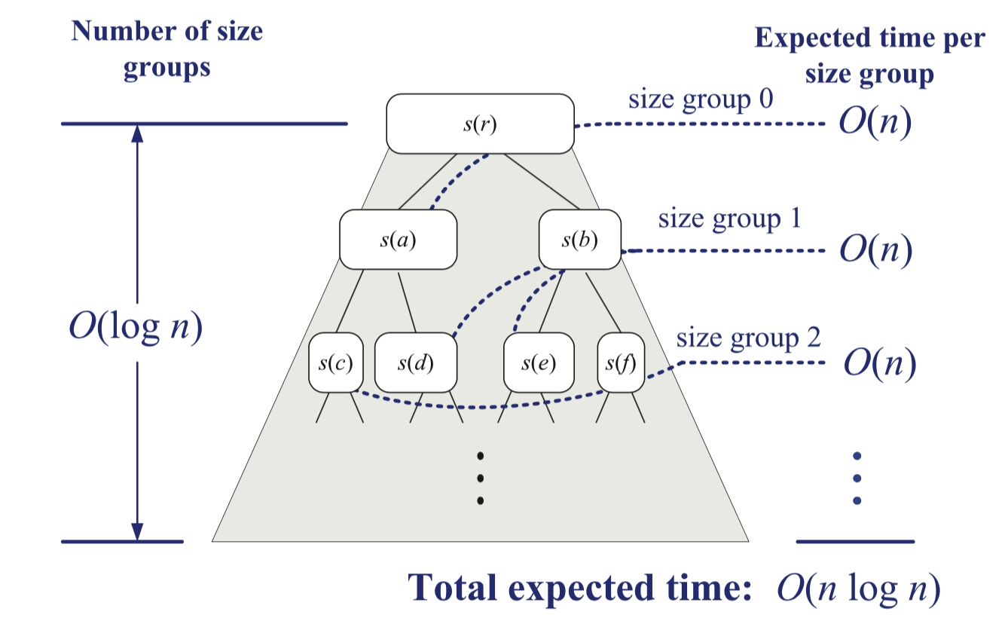

Expected Running Time (2)
Consider a binary tree T used in the Quick-sort.
Definition
A node v (a collection of elements) in T is said to be in size group i if ${\left(\frac{3}{4}\right)}^{\left\{i+1\right\}}n≤$ the size of v’s subproblem $≤{\left(\frac{3}{4}\right)}^{\left\{i\right\}}n$
Thus, every node is in some size group (e.g., the root node is in size group 0)

Slide 16
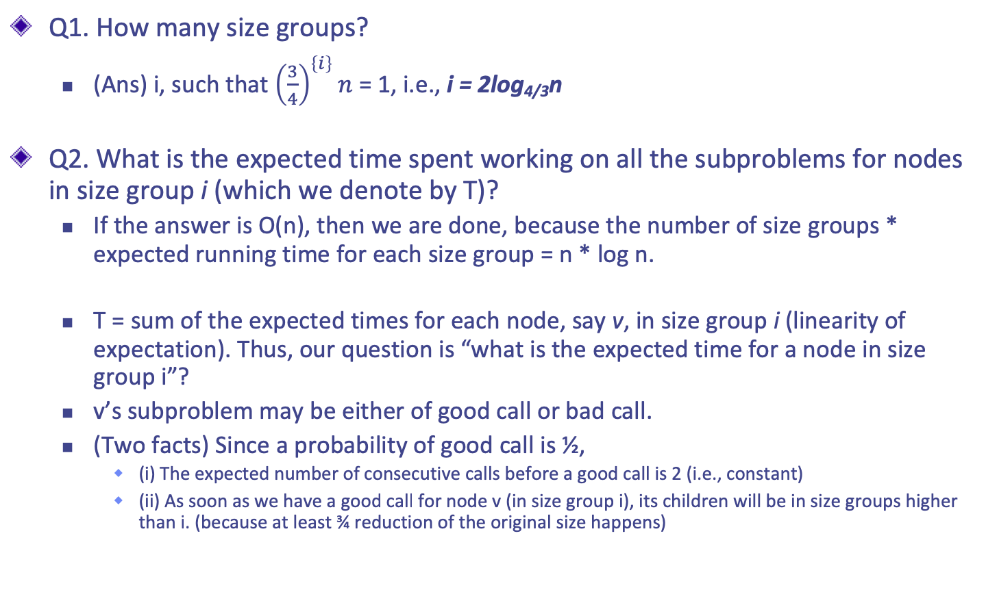
Expected Running Time (3)
Q1. How many size groups?
(Ans) i, such that ${\left(\frac{3}{4}\right)}^{\left\{i\right\}}n$ = 1, i.e., i = 2log_{4/3}n
Q2. What is the expected time spent working on all the subproblems for nodes in size group i (which we denote by T)?
If the answer is O(n), then we are done, because the number of size groups * expected running time for each size group = n * log n.
T = sum of the expected times for each node, say v, in size group i (linearity of expectation). Thus, our question is “what is the expected time for a node in size group i”?
v’s subproblem may be either of good call or bad call.
(Two facts) Since a probability of good call is ½,
(i) The expected number of consecutive calls before a good call is 2 (i.e., constant)
(ii) As soon as we have a good call for node v (in size group i), its children will be in size groups higher than i. (because at least ¾ reduction of the original size happens)

Slide 17
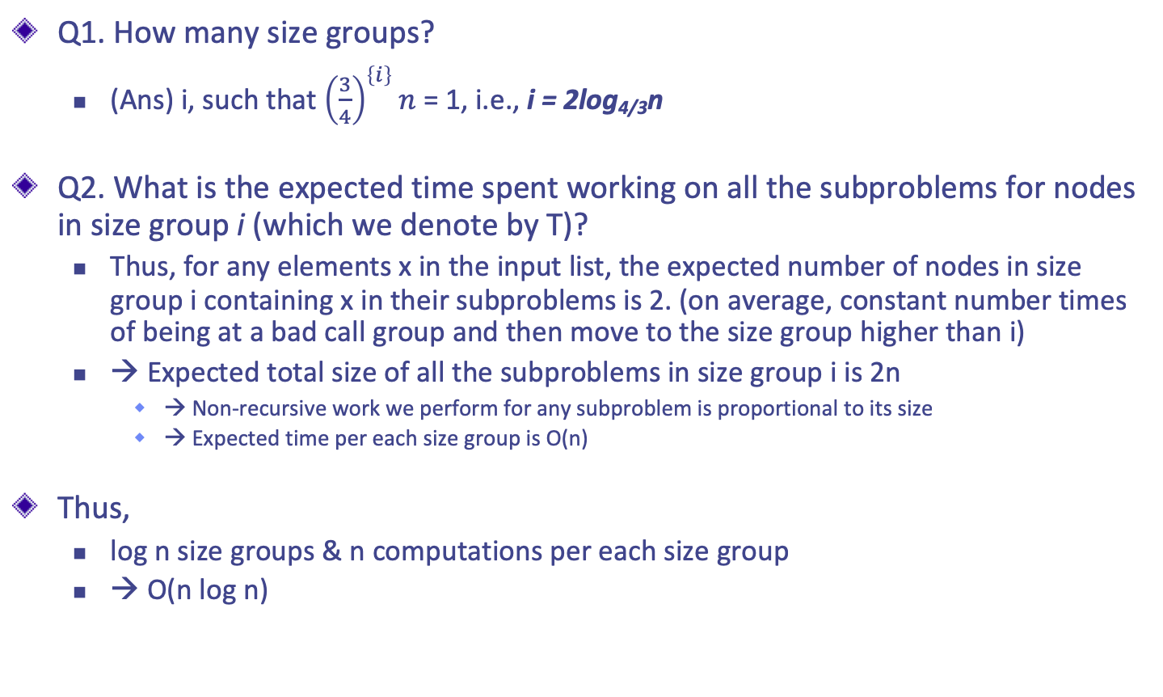
Expected Running Time (4)
Q1. How many size groups?
(Ans) i, such that ${\left(\frac{3}{4}\right)}^{\left\{i\right\}}n$ = 1, i.e., i = 2log_{4/3}n
Q2. What is the expected time spent working on all the subproblems for nodes in size group i (which we denote by T)?
Thus, for any elements x in the input list, the expected number of nodes in size group i containing x in their subproblems is 2. (on average, constant number times of being at a bad call group and then move to the size group higher than i)
→ Expected total size of all the subproblems in size group i is 2n
→ Non-recursive work we perform for any subproblem is proportional to its size
→ Expected time per each size group is O(n)
Thus,
log n size groups & n computations per each size group
→ O(n log n)

Slide 18
Summary of Sorting Algorithms
Algorithm | Time | Notes
selection-sort | O(n²) | in-place slow (good for small inputs)
insertion-sort | O(n²) | in-place slow (good for small inputs)
quick-sort | O(n log n) expected | in-place, randomized fastest (good for large inputs)
heap-sort | O(n log n) | in-place fast (good for large inputs)
merge-sort | O(n log n) | sequential data access fast (good for huge inputs)

